Slide 1
Welcome to the Carolina Lutheran Women
12th Annual Convocation
October 15, 2022

Slide 2
Greetings and Introductions
Ginger Klock, Chairwoman
– CLW Executive Board
Genevieve Baker, President
– Union Lutheran Church Women
Pastor Heidi Punt
– Union Lutheran Church

Slide 3
Opening Prayer
Pastor Heidi Punt
Union Lutheran Church

Slide 4
Be Thou My Vision
Be Thou my Vision, O Lord of my heart; Naught be all else to me, save that Thou art; Thou my best Thought, by day or by night, Waking or sleeping, Thy presence my light.
Be Thou my Wisdom, and Thou my true Word; I ever with Thee and Thou with me, Lord; Thou my great Father, I Thy true son; Thou in me dwelling, and I with Thee one.
Continued

Slide 5
High King of Heaven, my victory won, May I reach Heaven’s joys, O bright Heav’n’s Sun! Heart of my own heart, whatever befall, Still be my Vision, O Ruler of all.

Slide 6
Open Business Meeting

Slide 7
Business Session
Roll Call of CLW Affiliated Congregations -- Robin McLaughlin, Secretary, CLW Council
Approval of 2021 Convocation Minutes from April 2022
-- Robin McLaughlin

Slide 8
Business Session
Treasurer’s Report of Income/Expenses -- Cindy Miller
Treasurer, CLW Council
Presentation of 2023 Proposed Expenditure Budget
-- Cindy Miller,

Slide 9
Business Session
2023 CLW Council Election
-- Ginger Klock
Chairwoman, CLW Council
Presentation of Nominees

Slide 10
Business Session
Prayer before Voting
-- Pastor Tonya Brittain
Organ Lutheran Church
Voting by Ballot
Additional Business
-- Ginger Klock
Chairwoman, CLW Council

Slide 11
Offertory
Seek Ye First The Kingdom Of God
Seek ye first the kingdom of God And His righteousness And all these things shall be added unto you Allelu, alleluia
Continued

Slide 12
Ask and it shall be given unto you Seek and ye shall find Knock and the door shall be opened unto you Allelu, alleluia Seek ye first the kingdom of God And His righteousness And all these things shall be added unto you Allelu, alleluia

Slide 13
Offering Prayer
Prayer for these gifts
-- Pastor Dawn Rister
Salem Lutheran Church
Monetary offering will be given to NALC Disaster Relief.
In-Kind Gifts will be taken to Community Care Clinic.

Slide 14
Program
Symbols of Our Faith
As Shown Through Chrismons
Presented by CLW Council

Slide 15
Symbols of Our Faith As Shown Through Chrismons
Introduction/History
--Kay Weaver

Slide 16
Symbols of Our Faith As Shown Through Chrismons
IHS (Iota Eta Sigma)
--Robin McLaughlin

Slide 17
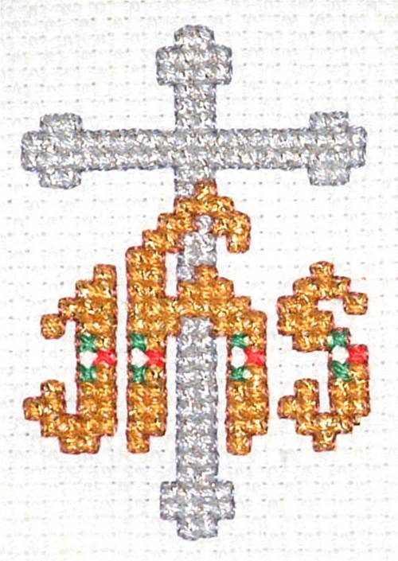
IHS

Slide 18
IHS

Slide 19
Jesus, Name above All Names
Jesus, name above all names Beautiful Savior, glorious Lord. Emmanuel, God is with us. Blessed Redeemer, Living word. Jesus, name above all names Beautiful Savior, glorious Lord. Emmanuel, God is with us. Blessed Redeemer, Living word. Emmanuel, God is with us. Blessed Redeemer, Living word.

Slide 20
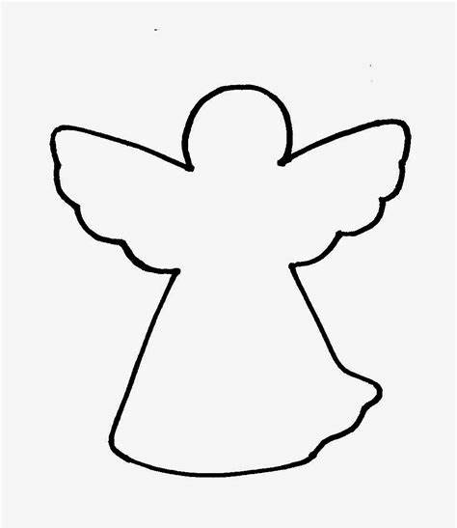
Symbols of Our Faith As Shown Through Chrismons
Angels
--Ginger Klock

Slide 21
Angels

Slide 22
Angels

Slide 23
Hark! The Herald Angels Sing
Hark! The herald angels sing, “Glory to the newborn King; Peace on earth, and mercy mild, God and sinners reconciled!” Joyful, all ye nations rise, Join the triumph of the skies; With th’angelic host proclaim, “Christ is born in Bethlehem!”
Refrain: Hark! the herald angels sing, “Glory to the newborn King!”
Continued

Slide 24
Christ, by highest Heav’n adored; Christ the everlasting Lord; Late in time, behold Him come, Offspring of a virgin’s womb. Veiled in flesh the Godhead see; Hail th’incarnate Deity, Pleased with us in flesh to dwell, Jesus our Emmanuel.
Refrain: Hark! the herald angels sing, “Glory to the newborn King!”

Slide 25
Symbols of Our Faith As Shown Through Chrismons
Manger
--Donna Shealy

Slide 26
Manger

Slide 27
Manger

Slide 28
Away in a Manger
Away in a manger, no crib for a bed The little Lord Jesus laid down his sweet head; The stars in the sky looked down where he lay The little Lord Jesus asleep in the hay The cattle are lowing, the baby awakes But little Lord Jesus, no crying he makes I love Thee, Lord Jesus, look down from the sky And stay by my cradle 'til morning is nigh
Be near me, Lord Jesus, I ask Thee to stay Close by me forever, and love me, I pray Bless all the dear children in thy tender care And fit us for heaven to live with Thee there

Slide 29
Symbols of Our Faith As Shown Through Chrismons
Shell and Chalice
--Robin McLaughlin

Slide 30
Shell and Chalice

Slide 31
Shell and Chalice

Slide 32
Lord, You Give the Great Commission
Lord, You give the great commission: “Heal the sick and preach the Word." Lest the Church neglect its mission, and the Gospel go unheard, Help us witness to Your purpose with renewed integrity, With the Spirit’s gifts empower us for the work of ministry.
Lord, You call us to Your service: “In My Name baptize and teach." That the world may trust Your promise, life abundant meant for each, Give us all new fervor, draw us closer in community. With the Spirit’s gifts empower us for the work of ministry.
Continued

Slide 33
Lord, You make the common holy: “This My body, this My blood." Let us all, for earth’s true glory, daily lift life heavenward, Asking that the world around us share your children’s liberty With the Spirit’s gifts empower us for the work of ministry.

Slide 34
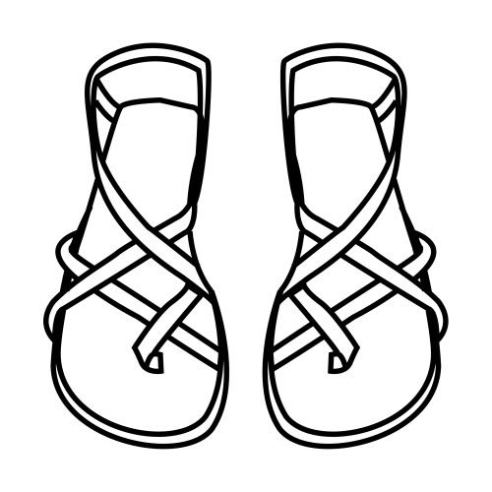
Symbols of Our Faith As Shown Through Chrismons
Sandals
--Ginger Klock
Sandals symbolizes our unworthiness, God’s holiness,
and our mission.

Slide 35
Sandals

Slide 36
Sandals

Slide 37
Go Tell It on the Mountain
Go tell it on the mountain
Over the hills and everywhere
Go tell it on the mountain
That Jesus Christ is born.
While shepherds kept their watching
O’er silent flocks by night,
Behold, throughout the heavens
There shone a holy light
Continued

Slide 38
Go tell it on the mountain
Over the hills and everywhere
Go tell it on the mountain
That Jesus Christ is born
Down in the lowly manger
The humble Christ was born.
And God sent our salvation
That blessed Christmas morn.
Go tell it on the mountain,
That Jesus Christ is born.
Jesus Christ is born.

Slide 39
Symbols of Our Faith As Shown Through Chrismons
Net with Fish
--Kay Weaver
The net with fish symbolizes Jesus calling His first disciples.

Slide 40
Net with Fish

Slide 41
Net with Fish

Slide 42
Lord, You Have Come to the Lakeshore
You have come down to the lakeshore Seeking neither the wise nor the wealthy, But only asking for me to follow. Sweet Lord, you have looked into my eyes, Kindly smiling, you've called out my name. On the sand I've abandoned my small boat; Now with you, I will seek other seas.
Continued

Slide 43
You need my hands, my exhaustion, Working love for the rest of the weary, A love that's willing to go on loving. Sweet Lord, you have looked into my eyes, Kindly smiling, you've called out my name. On the sand I've abandoned my small boat; Now with you, I will seek other seas.
Continued

Slide 44
You who have fished other waters; You, the longing of souls that are yearning; O loving Friend, you have come to call me. Sweet Lord, you have looked into my eyes, Kindly smiling, you've called out my name. On the sand I've abandoned my small boat; Now with you, I will seek other seas.

Slide 45
Symbols of Our Faith As Shown Through Chrismons
Cross
--Cindy Miller

Slide 46
Cross

Slide 47
Cross

Slide 48
Lift High the Cross
Lift High The Cross, The Love Of Christ Proclaim, Till All The World Adore His Sacred Name.
Come, Christians, Follow Where Our Saviour Trod, Our King Victorious, Christ, The Son Of God.
Continued

Slide 49
Lift High The Cross, The Love Of Christ Proclaim, Till All The World Adore His Sacred Name.
O Lord, Once Lifted On This Glorious Tree, As Thou Hast Promised, Draw Men Unto Thee.
Lift High The Cross, The Love Of Christ Proclaim, Till All The World Adore His Sacred Name.

Slide 50
Symbols of Our Faith As Shown Through Chrismons
Butterfly
--Donna Shealy

Slide 51
Butterfly

Slide 52
Butterfly

Slide 53
Jesus Christ Is Risen Today
Jesus Christ is risen today, Alleluia! Our triumphant holy day, Alleluia! Who did once, upon the cross, Alleluia! Suffer to redeem our loss, Alleluia!
Hymns of praise then let us sing, Alleluia! Unto Christ, our heavenly King, Alleluia! Who endured the cross and grave, Alleluia! Sinners to redeem and save, Alleluia!
Continued

Slide 54
But the pain which He endured, Alleluia! Our salvation hath procured, Alleluia! Now above the sky He's king, Alleluia! Where the angels ever sing, Alleluia!
Sing we to our God above, Alleluia! Praise eternal as His love, Alleluia! Praise Him, all you heavenly host, Alleluia! Father, Son, and Holy Ghost, Alleluia!

Slide 55
Symbols of Our Faith As Shown Through Chrismons
Alpha and Omega
--Ginger Klock

Slide 56
Alpha and Omega

Slide 57
Alpha and Omega

Slide 58
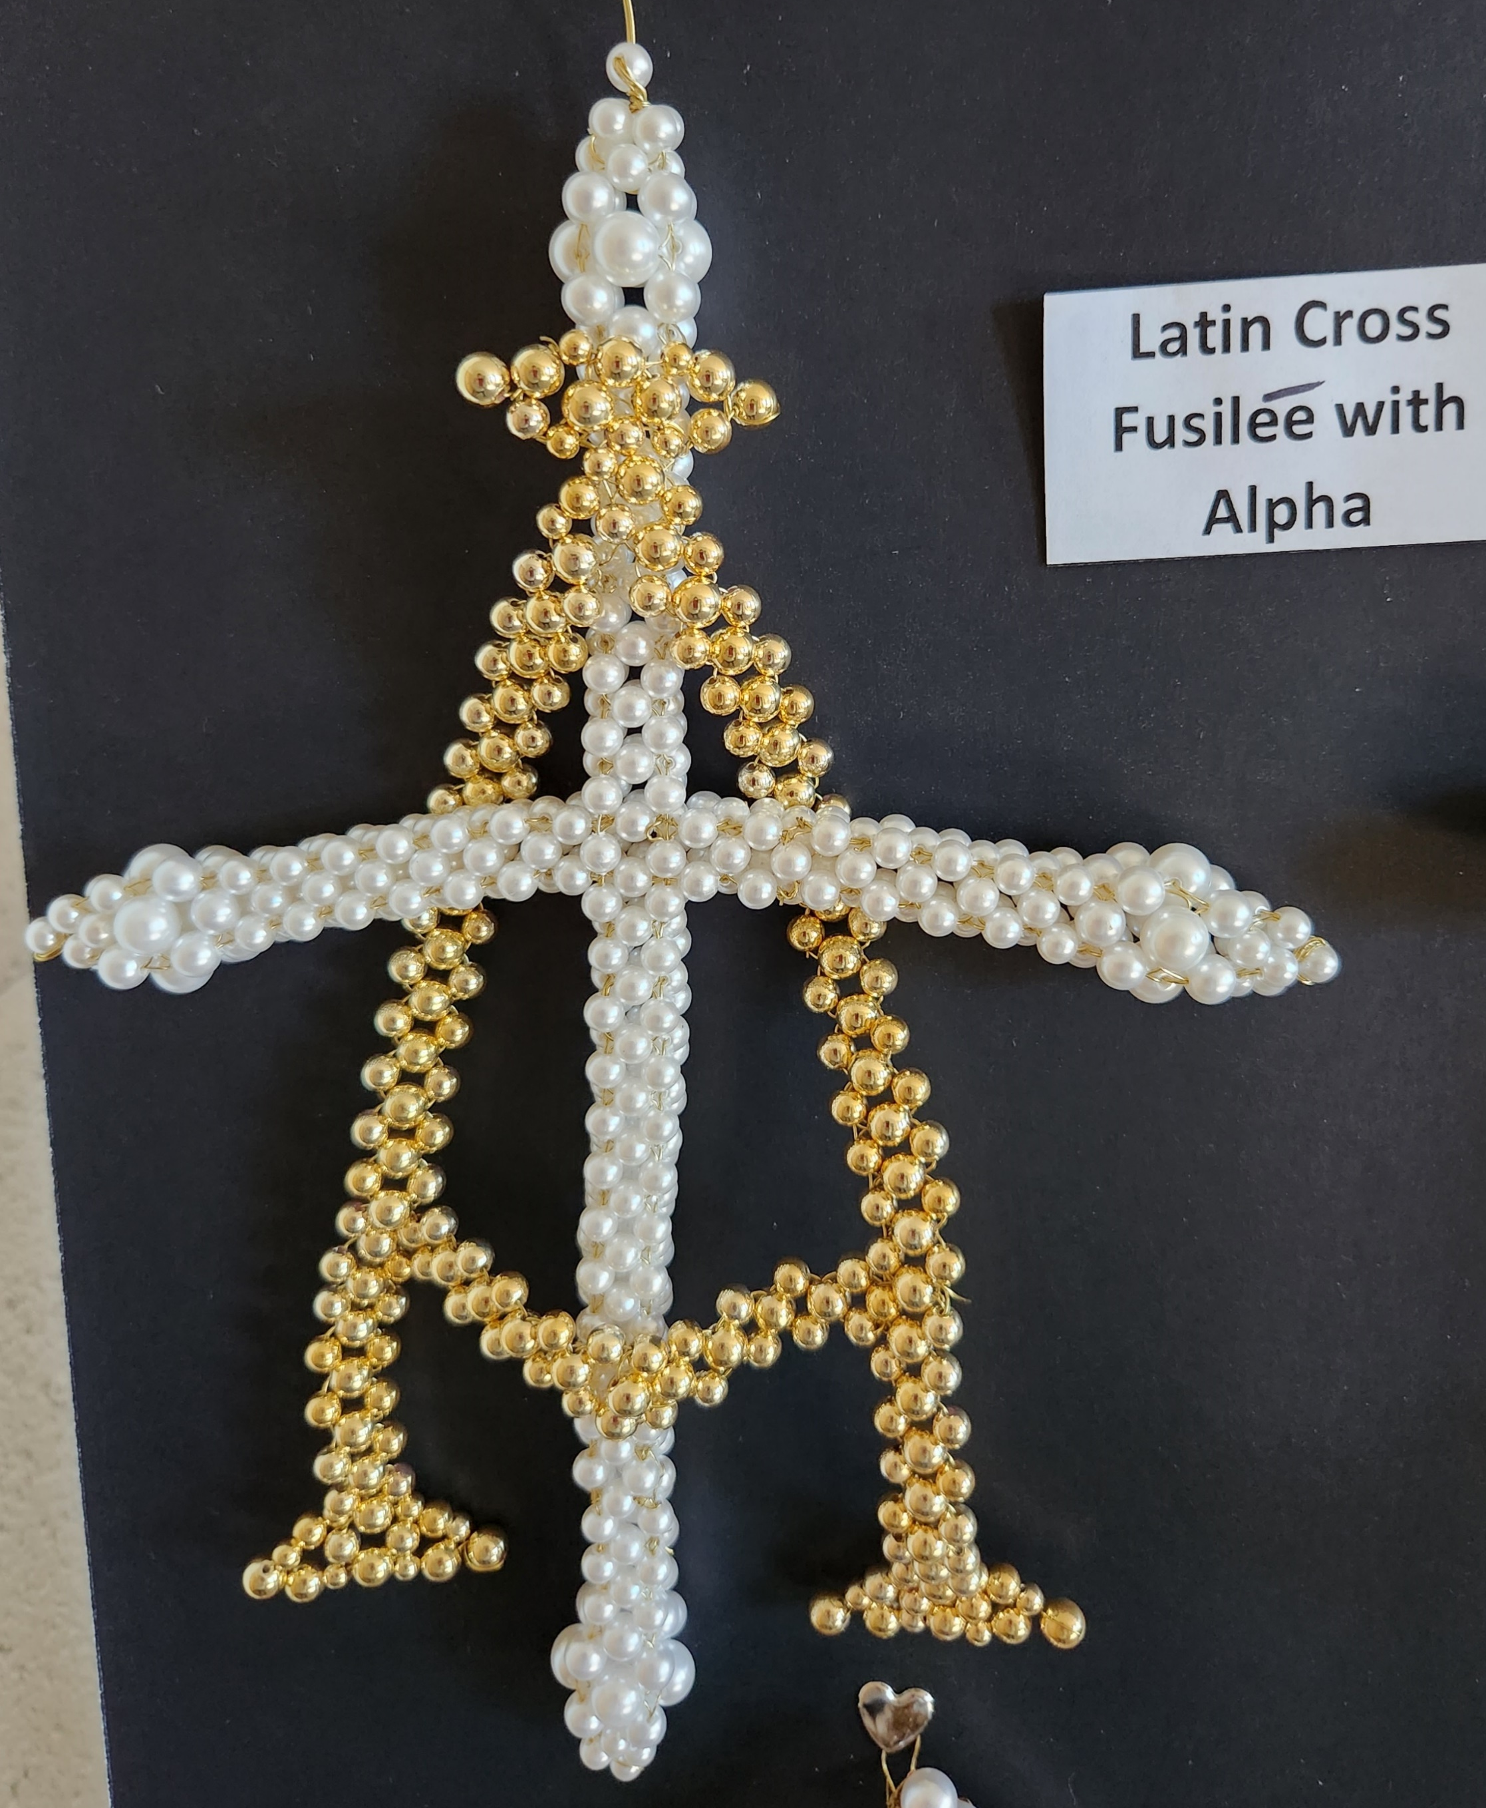
Alpha and Omega

Slide 59
Love Devine, All Loves Excelling
Love divine, all loves excelling, joy of heav’n, to earth come down, fix in us thy humble dwelling, all thy faithful mercies crown. Jesus, thou art all compassion, pure, unbounded love thou art. Visit us with thy salvation; enter ev'ry trembling heart.
Continued

Slide 60
Breathe, O breathe thy loving Spirit into ev’ry troubled breast. Let us all in thee inherit, let us find the promised rest. Take away the love of sinning; Alpha and Omega be. End of faith, as its beginning, set our hearts at liberty.
Finish, then, thy new creation; true and spotless let us be. Let us see thy great salvation perfectly restored in thee. Changed from glory into glory, till in heav’n we take our place, till we cast our crowns before thee, lost in wonder, love and praise

Slide 61
Announcements
Please complete the yellow Evaluation Form found in your folder in your bag.
Please locate the Cutout Christmas ornament found in your folder in your bag and put:
Your name
Your complete mailing address
The month and day of your birthday
Go hang it on the Christmas tree
Pick up an ornament on you way out
Pray for your Secret Prayer Sister, send birthday cards, notes throughout the year—Thinking of You and Christmas Cards

Slide 62
Lunch
Blessing Our Meal
--Pastor Marty Raymer
New Covenant Lutheran
Instructions for getting lunch
--Genevieve Baker
Union Lutheran

Slide 63
Business Meeting
Election Results
--Ginger Klock
Installation Service of Carolina Lutheran Women’s Council
--Kim Isiminger
WNALC Representative
Christ the King, Evans, GA

Slide 64
INSTALLATION SERVICE OF CAROLINAS LUTHERAN WOMEN’S COUNCIL
Leader: Our scripture reading for this installation service comes from 1 Corinthians 12:4-7. “Now there are varieties of gifts, but the same Spirit; and there are varieties of service, but the same Lord; and there are varieties of working; but it is the same God who inspires them all in everyone. To each is given the manifestation of the Spirit for the common good.”
Leader: The Carolinas Lutheran Women want to recognize these individuals who have willingly stepped forward to continue the traditions begun decades ago by groups of women in each of their own churches and in their communities. In our history, we have strived to utilize our time, talents, and treasures towards the betterment of our congregation, our community, and ourselves. In our endeavors we have called upon the love and guidance of our heavenly Father. Ladies, are you, individually and as the Carolinas Lutheran Women’s Council, willing to continue this tradition? If so, answer: “Yes, with the help of God.”

Slide 65
Elected Leaders: “Yes, with the help of God.”
Leader: As a sign of support for these leaders and for Carolinas Lutheran Women, I ask those gathered here to stand.
Leader: Will you support and pray for these elected leaders? Will you be partners with them in the ministry of this organization?
All Women: “Yes, with the help of God.”
Leader: In accordance with this affirmation, everyone repeats after me the Mission Statement of the Carolinas Lutheran Women:
Leader/All Women: As sisters in Christ, led by the Holy Spirit, we dedicate ourselves to serve God by using the gifts, we have received to reach out to others.

Slide 66
Leader: Thank you! Now let us bow our heads for prayer: Lord, Jesus, to whom nothing is new or surprising, for You know all things, we ask for Your gracious guidance as the newly installed Council assumes the responsibilities of the office. Grant them the grace to be faithful stewards of the talents entrusted by Your providence to their care. Help them to apply themselves in such a way that their work will be fruitful and pleasing to You. Give them a sense of honor and loyalty, and keep them mindful of the accounting they must render to You for their stewardship. Above all, give each of us a true sense of our Christian vocation so that in all things You may be glorified. Keep us humble in the midst of the successes, positive in the face of disappointments, determined in spite of difficulties, and honest in all our dealings. Bless our work and use each of us to be a blessing to others. Hear us, Lord Jesus, we pray. AMEN
Leader: Carolinas Lutheran Women, I present to you the Council Members for the upcoming year. Thank you. You may be seated

Slide 67
Special Activity
Move to other hall for our special activity
--Cindy Miller
Organ Lutheran Church

Slide 68
Closing
Closing Remarks
--Ginger Klock
Benediction
--Pastor Heidi Punt

Slide 69
Amazing Grace
Amazing grace how sweet the sound That saved a wretch like me I once was lost, but now I'm found Was blind, but now I see
'Twas grace that taught my heart to fear And grace my fears relieved How precious did that grace appear The hour I first believed Continued

Slide 70
The Lord has promised good to me His word my hope secures; He will my shield and portion be, As long as life endures.
When we've been there ten thousand years Bright shining as the sun, We've no less days to sing God's praise Than when we've first begun.

Slide 71
Goodbye
Safe travels
Have a great year
See you next year

